Slide 1

Lecture 1 Introduction to modelling
Lecturer: James Wood, UNSW Sydney

Slide 2
What are mathematical models?
Mathematical models are conceptual tools that aim to explain and/or predict how a real-world process or system behaves or will behave under change.
The properties of a mathematical model must correspond in some way to the real-world process or system but are a simplification.
Epidemiological models of infectious disease represent in a simplified manner the many processes involved in the spread and control of disease.
Key differences to other population disease models include
Exposure to another case is often a risk factor
Disease-specific immune responses often influence transmission
Interventions can be extremely effective (elimination may be possible)

Slide 3

What are mathematical models?
A “good” model is suited to its purpose—that is, it should be as simple as possible and no simpler.
Occam's razor or principle of parsimony

Slide 4
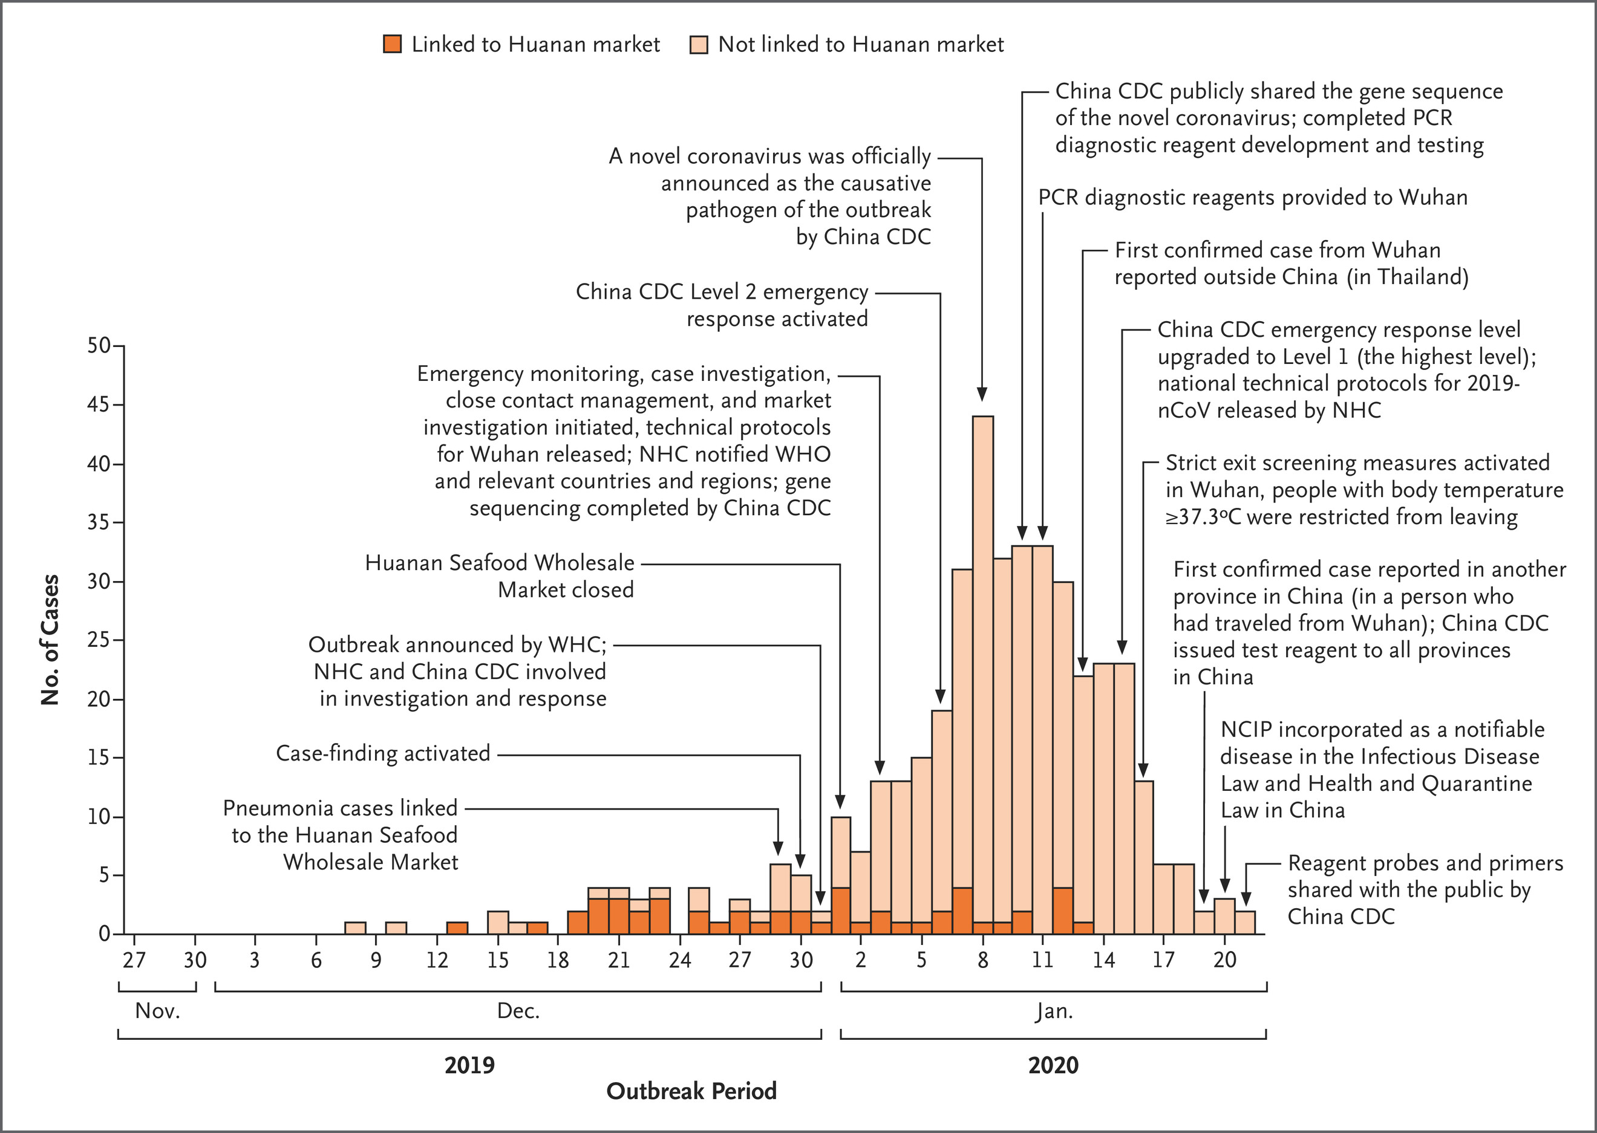
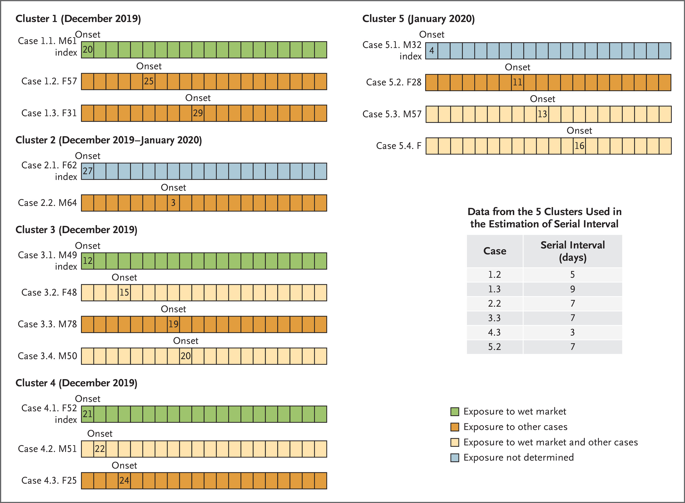
Uses of math models in ID research and policy?
Understanding and discovery:
E.g. use of epidemic curve and infector-infectee pair data to estimate R0 for SARS-CoV-2 in Jan 2020
Li 2020. https://www.nejm.org/doi/full/10.1056/NEJMoa2001316

Slide 5
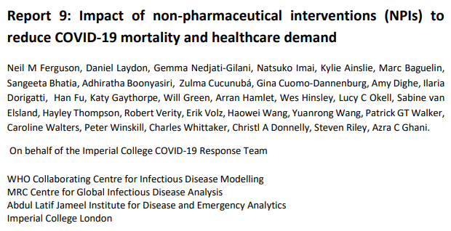
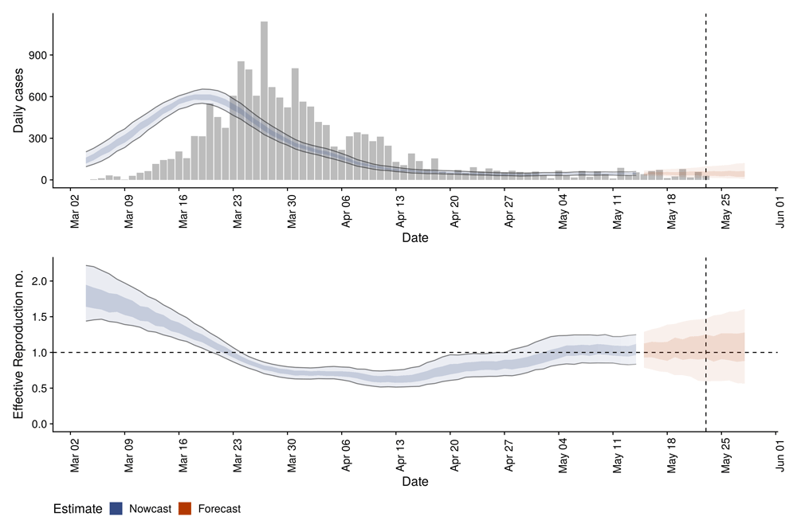
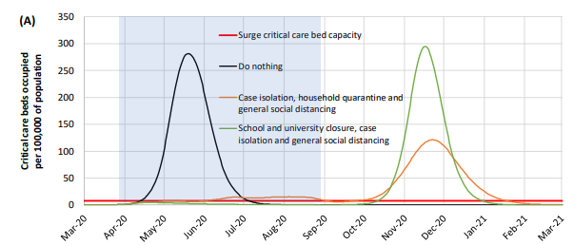
Uses of math models in ID research and policy?
Analysis of trends in space or time, including under PH intervention
E.g. use of epidemic curve and infector-infectee pair data to estimate R0 for SARS-CoV-2 in Jan 2020
Li 2020. https://www.nejm.org/doi/full/10.1056/NEJMoa2001316

Slide 6
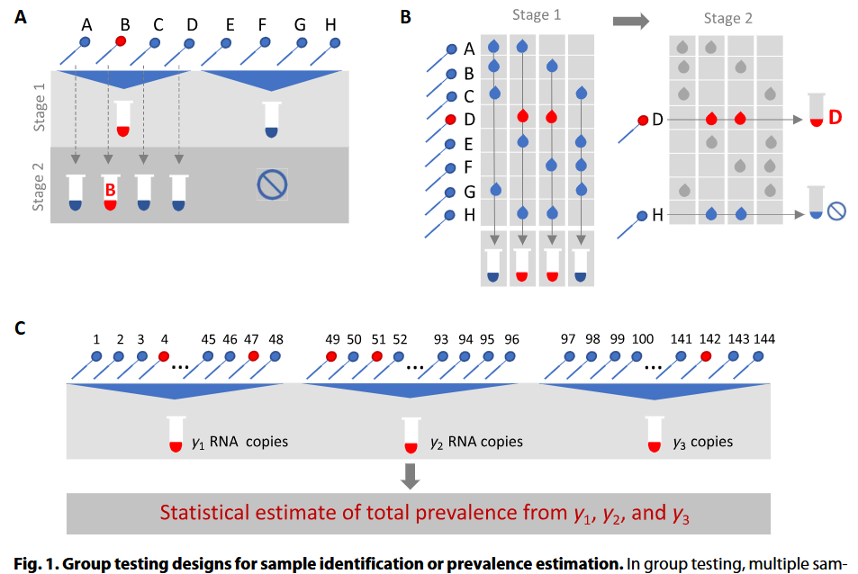
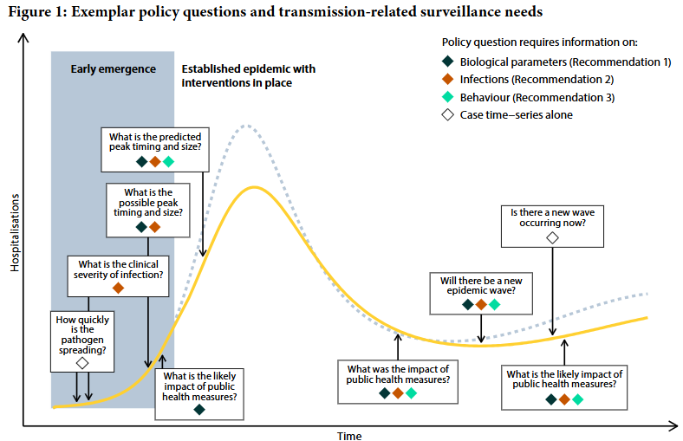
Uses of math models in ID research and policy?
Informing surveillance design
Cleary et. al. https://www.science.org/doi/10.1126/scitranslmed.abf1568
Shearer et. al. https://ojs.cdi.cdc.gov.au/index.php/cdi/article/view/2708/2703

Slide 7
Mechanistic versus statistical models
Mechanistic models (principal driven) describe how a process works, based on underlying physical or biological laws
E.g. model describes how a susceptible person contacts an infectious person and becomes infected
Statistical models (data driven) describe what is observed in data without necessarily explaining the cause
E.g. model describes trends in a time-series of case notifications
Models can be in-between!

Slide 8
Many different types of models
Classification by purpose:
Predictive versus descriptive/explanatory
Classification by mathematical characteristics:
Mechanistic (principle driven) or statistical (data driven) or both
Temporal or spatial (or both)
Deterministic or stochastic
Compartmental or agent-based
Classification by epidemiological characteristics
Directly or indirectly transmitted
Recovery or lifelong infection
Partial or complete immunity
Predictive
E.g. forecasting
Statistical
Mechanistic
E.g. “what if” scenarios
E.g. R_{e} analysis
E.g. identify why X drives transmission
Explanatory

Slide 9
The modelling process
Define question or purpose
Model design. What is known about the system? What data are available?
Interventions implemented and/or new data collected
Consult with policymakers, other domain experts, and data custodians
Analysis. Validity checks: are my results sensible given the question and data?
Scientific insight and/or policy advice
Uncertainty and sensitivity analysis

Slide 10
An appropriate level of complexity?
Models range from simple (e.g. grouping individuals into compartments) to highly complex (e.g. simulating the behaviour of all individuals in a large population)
The required complexity of a model depends on:
The specific research question/purpose
Existing knowledge of the system
Available data
Timeframe for analysis and computational resources
Model complexity not generally an indicator of its utility
Trade-offs between the degree of realism (complexity, specificity) and understanding (simplicity, generalisability)
More complex models require more detailed data for parameterization

Slide 11
Approach shaped by health interest/timeframe
Three Streams Model
John W. Kingdon. Agendas, Alternatives, and Public Policies. HarperCollins College Publishers. 1995.
Problem
Policy Window
Policy
Implementation
Politics
Desire for modelling results, often yesterday!
Agenda Setting
Softening up Phase | Coupling Phase
Enactment
Implementation
Slide adapted from presentation by Richard Gray, KI

Slide 12
Data may not separate between competing assumptions
Non-identifiability occurs when differing sets model inputs or assumptions produce the same or very similar outputs.
E.g. What if we used a model to estimate the susceptibility to infection of children versus adults from only case data?
Model input parameters
Cases (model output)
Low
High
Children
Susceptibility to infection
Cases
Adults
Prob of seeking care/test
Children
Adults

Slide 13
Uncertainty and sensitivity analysis
Uncertainty analysis — quantify the range of model outputs produced due to uncertainties in model inputs.
Sensitivity analysis — determine which of the uncertain model inputs have the greatest influence on model outputs (and subsequent conclusions).
Notes:
In one-way sensitivity analysis, a single input is varied at a time, with output sensitivities then summarized e.g. through tornado plots which represent both the direction (increase or decrease) and relative magnitude of changes in outcomes that result from one-way sensitivity analysis on a series of inputs, providing a comparative overview of which inputs are most influential.

Slide 14
Uncertainty and sensitivity analysis
Uncertainty analysis — quantify the range of model outputs produced due to uncertainties in model inputs.
Consider a deterministic model where for same inputs, always get the same results
Uncertain input parameters
Model output
Single fixed parameter values
R0
Model
Deaths
VE
No vaccine
Vaccine
Difference

Slide 15
Uncertainty and sensitivity analysis
Uncertainty analysis — quantify the range of model outputs produced due to uncertainties in model inputs.
Uncertain input parameters
Model output
R0
Model
Deaths
VE
Range or distribution of parameter values
No vaccine
Vaccine
Difference

Slide 16
Uncertainty and sensitivity analysis
Sensitivity analysis — determine which of the uncertain model inputs have the greatest influence on model outputs (and subsequent conclusions).
One-way sensitivity analysis summarised as “tornado” plot (Devine et al 2025)

Slide 17
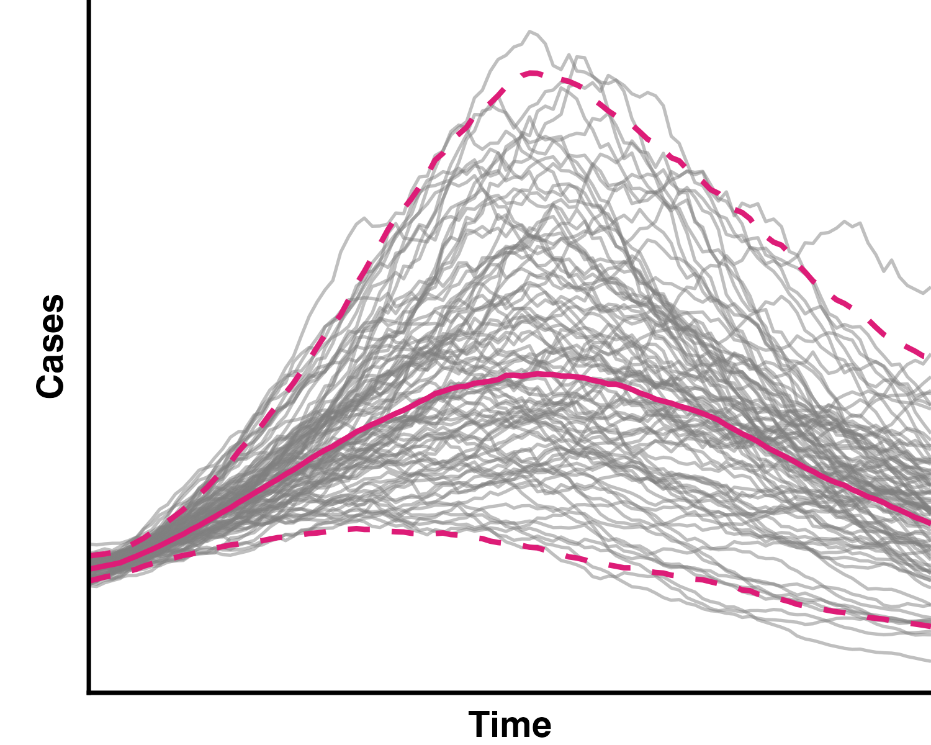
Uncertainty and sensitivity analysis
Becomes more complex in the context of models with random elements (stochastic models – to be covered later).
Generally want to represent both uncertainty/sensitivity due to parameters as well as random events.
Stochastic model outputs
and credible intervals for same inputs across many simulation

